Slide 1
Effective Oral Presentations
For Problem-Based Learning Panel Presentations
Created by Sharon Motel, Library Media Specialist Substitute Teacher, Forest Glen Elementary School, Glen Ellyn, IL, November, 2014

Slide 2
Grasp the subject, the words will follow.
Cato the Elder, Roman Statesman, ca. 160 B.C.

Slide 3
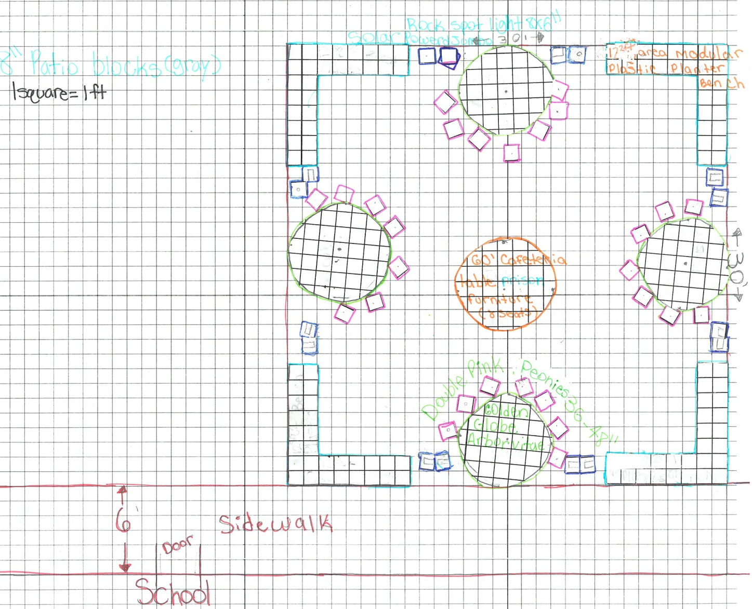

Slide 4
Problem and Solution Speech− Organizational Format
These speeches are organized by explaining the problem and then, introducing solutions. For example, Acid Rain.
Define acid rain.
Explain its causes.
Discuss the impact of acid rain.
Offer ideas for stopping the causes and/or lessoning the effects of acid rain.
Source: Palmer, Erik. Well Spoken Teaching Speaking to All Students. Portland, Me.: Stenhouse, 2011. Print.
Image: "Acid Rain Facts, Acid Rain Information, Acid Rain Pictures, Acid Rain Effects - National Geographic." National Geographic. N.p., n.d. Web. 14 Nov. 2014.

Slide 5
Problem
with Special Considerations
Solution’s Special Considerations
Source: "The Problem." Level 3 STEAM PBL. Forest Glen Elementary School, n.d. Web. 14 Nov. 2014.

Slide 6
PowerPoint Tips
Choose a font style that your audience can read from a distance.
Keep your text simple by using bullet points or short sentences.
Use art to help convey your message.
Label charts and graphs.
Make slide backgrounds subtle and keep them consistent.
Use high contrast between background color and text color.
Check the spelling and grammar.
Minimize the number of slides.
"Tips for Creating and Delivering an Effective Presentation." Office PowerPoint. Microsoft, n.d. Web. 18 Nov. 2014.

Slide 8
Before the Actual Presentation…
Number 1 Rule of Good Public Speaking:
Know your material. Content should be well-prepared in advance so that you are focusing on delivery, as opposed to the message, on speech day.
Source: Rister, Alex. "3 Eye Contact Myths… and How to Avoid Them In Your Speech." Six Minutes RSS. N.p., 13 Jan. 2013. Web. 14 Nov. 2014.

Slide 9
Grabber Openings
“Hi, my name is Gabe and I’m going to tell you about …”
The challenge.
The provocative question.
The powerful quote.
The surprising statistic.
The unusual fact.
The poignant story.
The teaser.
Source: Palmer, Erik. Well Spoken Teaching Speaking to All Students. Portland, Me.: Stenhouse, 2011. Print. pp. 36-37.

Slide 10
Project and Use Your Voice
Speak from your diaphragm.
Aim for a spot at the back of the group.
Relax. Speak slowly and clearly.
To underline a special point, go even more slowly or repeat it.

Slide 11
Don’t Read Your Speech
Bor’-ing, adj.
Uninteresting and tiresome; dull.
A speaker reading their entire speech.
Do Use Notes
Bring notecards or a sheet of paper with key words or phrases.
Use large printing or a font that you can easily see at a glance from 3 feet away.
No full sentences.
Source: Dlugan, Andrew. "Never Read Your Speech… Never?" Six Minutes RSS. N.p., 21 Oct. 2009. Web. 14 Nov. 2014.

Slide 12
Maintain Effective Eye Contact and Facial Expressions
Eye Contact
Presenters: Work the room with your eyes. People can tell when you look at the back of the room, at their foreheads, or stare continuously. Panel members: Focus on the speaker or audience members.
Facial Expressions
Presenters: Practice in front of a mirror to see that your expressions are appropriate for your talk.
Panel members: Look interested.
Sources: Rister, Alex. "3 Eye Contact Myths… and How to Avoid Them In Your Speech." Six Minutes RSS. N.p., 13 Jan. 2013. Web. 14 Nov. 2014.
Palmer, Erik. Well Spoken Teaching Speaking to All Students. Portland, Me.: Stenhouse, 2011. Print.

Slide 13
Posture and Body Language
Always stand or sit straight. Good posture projects confidence. Try to look relaxed.
When you are not the speaker, be engaged. Focus on the speaker and the presentation.
Body language that conveys disinterest, boredom, or lack of confidence:
Yawning
Poor posture, “sagging”
Downcast eyes, staring, looking elsewhere
Dull, blank, emotionless face
Fidgeting, repetitive actions

Slide 14
Language
Use Formal English in PBL presentations.
Formal English is used in “serious” texts and situations — for example, in official documents, books, news reports, articles, business letters or official speeches. Informal English is used in everyday conversations and in personal letters.
Let’s compare!
Source: Szynalski, Tomasz P. "Formal and Informal English." How to Learn English Effectively. Antimoon, n.d. Web. 13 Nov. 2014.

Slide 15
Enunciation and Pronunciation
Speak clearly and think about your pacing.
Learn how to pronounce content-specific vocabulary. Review aloud with an adult and/or use the audio icon on .

Slide 16
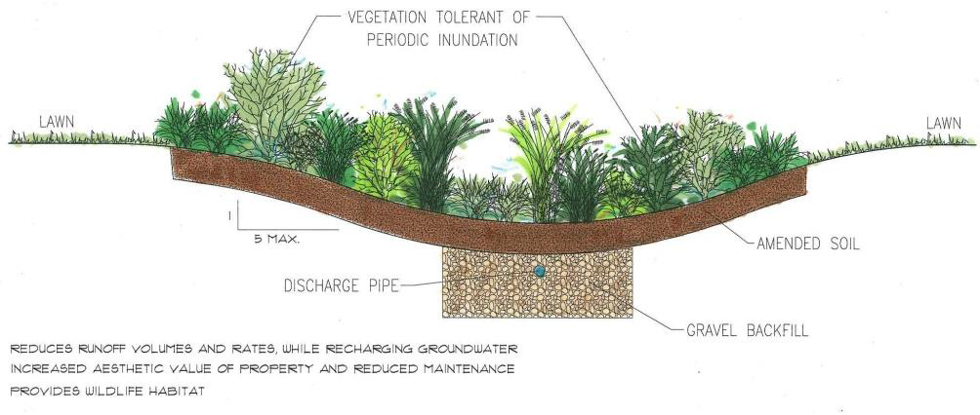
Pronunciation
Aesthetic
Source: PBL Presentation: Outdoor Learning Space. FGM Architects, 16 Oct. 2014. PPT.

Slide 17
Practice, Practice, Practice
According to the Department of Communication at the University of Pittsburgh, most people experience some level of speech anxiety when they have to speak in front of a group. Remember:
Experiencing speech anxiety is normal.
Nearly everyone gets nervous when they have to give a speech or a presentation, even experienced speakers.
The audience wants you to succeed!
Recommendation: Practice delivering your speech at least 7 to 10 times before your actual presentation.
Source: "Speech Anxiety." Speaking in the Disciplines. University of Pittsburgh, 21 Aug. 2008. Web. 12 Nov. 2014.

Slide 18
Works Cited
"Acid Rain Facts, Acid Rain Information, Acid Rain Pictures, Acid Rain Effects - National Geographic." National Geographic. N.p., n.d. Web. 14 Nov. 2014.
"Cato The Elder Quotes." WorldofQuotes. N.p., n.d. Web. 17 Nov. 2014.
Dlugan, Andrew. "Never Read Your Speech… Never?" Six Minutes RSS. N.p., 21 Oct. 2009. Web. 14 Nov. 2014.
Palmer, Erik. Well Spoken Teaching Speaking to All Students. Portland, Me.: Stenhouse, 2011. Print.
PBL Presentation: Outdoor Learning Space. N.p.: FGM Architects, 16 Oct. 2014. PPT.
"The Problem." Level3 STEAM PBL. Forest Glen Elementary School, n.d. Web. 14 Nov. 2014.
Rister, Alex. "3 Eye Contact Myths… and How to Avoid Them In Your Speech." Six Minutes RSS. N.p., 13 Jan. 2013. Web. 14 Nov. 2014.
"Speech Anxiety." Speaking in the Disciplines. University of Pittsburgh, 21 Aug. 2008. Web. 12 Nov. 2014.
"Tips for Creating and Delivering an Effective Presentation." Office PowerPoint. Microsoft, n.d. Web. 18 Nov. 2014.
Szynalski, Tomasz P. "Formal and Informal English." How to Learn English Effectively. Antimoon, n.d. Web. 13 Nov. 2014.

